Slide 1
HTML Page Structure

Slide 2
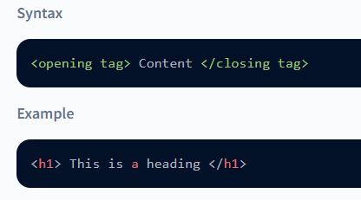
HTML Elements
The three main parts of the HTML elements are:
Opening Tag: It marks the start of the element.
Content: The contents that are visible on the browser.
Closing Tag: It marks the end of the element. Usually, it starts with a backward slash '/'.

Slide 3
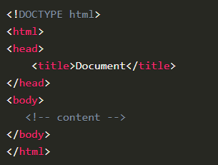
HTML Page Structure
An HTML document is structured using a set of nested tags. Each tag is enclosed
within <…> angle brackets and acts as a container for content or other HTML tags. Let's take a look at a basic HTML document structure

Slide 4
DOCTYPE Declaration
HTML Root Element
All the contents of the website will be inside this opening and closing tag. It tells the browser that the content of the file is HTML.
Head Section
The head tag contains additional information about the website. The content inside the head tag will not be visible on your browser.
The <!DOCTYPE html> declaration informs the web browser about the HTML version
being used. The latest version is HTML5.
The <head> tag contains metadata and links to external resources like CSS and
JavaScript files.

Slide 5

Title Tag
The title tag is present inside the <head> tag. The text present inside the tags appears at the top of the browser window.
Body Tag
The body tag contains all the contents of the webpage. Everything you see on the web browser will be present inside the body tag.

